Slide 1
FLOOD MONITORING AND EARLY WARNING SYSTEM
DEPARTMENT OF COMPUTER SCIENCE AND ENGINEERING
TEAM MEMBERS:
1.Navadeep 113321104020
2.Dravid 1133211104021
3.Gnaneswaran 13321104024
4.Harshavardan reddy 113321104029
5.Mohan kumar 113321104061
PHASE 3
TEAM NAME:
Proj_224785_Team_3

Slide 2
INNOVATION:
1.Remote Sensing and Satellite Technology: Satellites equipped with advanced sensors and radar systems can monitor weather patterns and water levels in real-time. This information is crucial for predicting floods and providing early warnings. Organizations like NASA and NOAA use these technologies for flood monitoring.
2.IoT and Sensors: Internet of Things (IoT) devices and sensors can be deployed in flood-prone areas to measure parameters such as water levels, rainfall, and soil moisture. These sensors can transmit data in real-time to a central monitoring system, enabling early warnings based on data-driven insights.
3.Artificial Intelligence (AI): AI and machine learning algorithms are being used to process large volumes of data from various sources, including satellite imagery, weather forecasts, and sensor data. AI can help identify flood patterns, predict flood events, and issue early warnings with greater accuracy.

Slide 3
PROJECT OBJECTIVES:
1.Early Detection and Warning:
Provide early and accurate detection of meteorological conditions and rising water levels to issue timely flood warnings.
2.Risk Assessment:
Evaluate the potential impact of flooding on communities, infrastructure, and the environment.
3.Public Safety:
Protect the lives of residents in flood-prone areas by providing clear and effective warnings and evacuation information.
4.Property Protection:
Minimize damage to homes, businesses, and infrastructure through timely flood warnings and risk communication.
5.Infrastructure Resilience:
Support the design and construction of resilient infrastructure that can withstand or mitigate flood impacts.

Slide 4
PROJECT REQUIREMENTS:
1.Project Scope and Objectives:
Define the specific goals and objectives of the system, including the geographical area it will cover, the types of floods it will address (e.g., riverine, flash floods, coastal), and the level of early warning desired.
2.Stakeholder Identification:
Identify all stakeholders, including government agencies, local communities, emergency services, and NGOs, that will be involved in the project.
3.Budget and Funding Sources:
Specify the project budget, including funding sources and financial constraints.
4.Early Warning Criteria:
Set clear and specific criteria for issuing flood warnings, such as trigger thresholds for various parameters (e.g., river levels, rainfall intensity).
5.Sensor Deployment:
Define the number and types of sensors (water level sensors, rainfall gauges, weather stations, etc.) required and their locations.

Slide 5
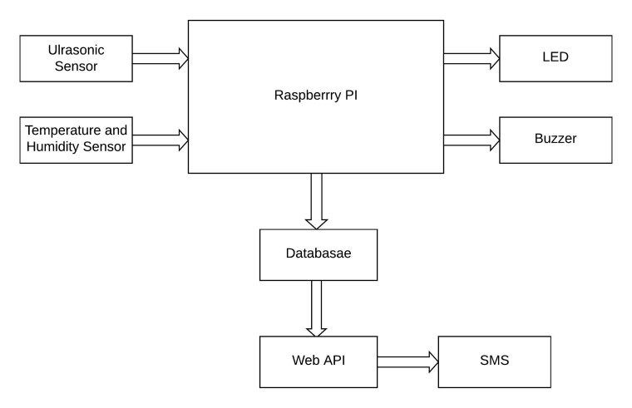
RASPBERRY PI INTEGRATION:

Slide 6
CODE IMPLEMENTATION:
HARDWARE COMPONENTS: PYTHON SCRIPT DEVELOPMENT: PYTHON SCRIPT
1.Raspberry Pi 1.Setting Up the Central Server DEVELOPMENT FOR
2.Water Flow Sensor Environment CENTRAL SERVER:
3.Solenoid Valve 2.Data Reception
4.Wi-Fi Module 3.Data Storage 1.Importing Required
5.Power Supply 4.Data Visualization Libraries
5.Error Handling 2.Data Visualization
SOFTWARE COMPONENTS: 6.Testing 3.Data Processing and
1.MQTT 7.Control Logic Analysis
2.Python 8.Documentation 4.User Authentication
3.Cloud server 9.Power Management and Access Control
5.Security Measures
6.Automation and Script
Execution
7.Testing and Debugging
8.Data Reception and
Storage

Slide 7
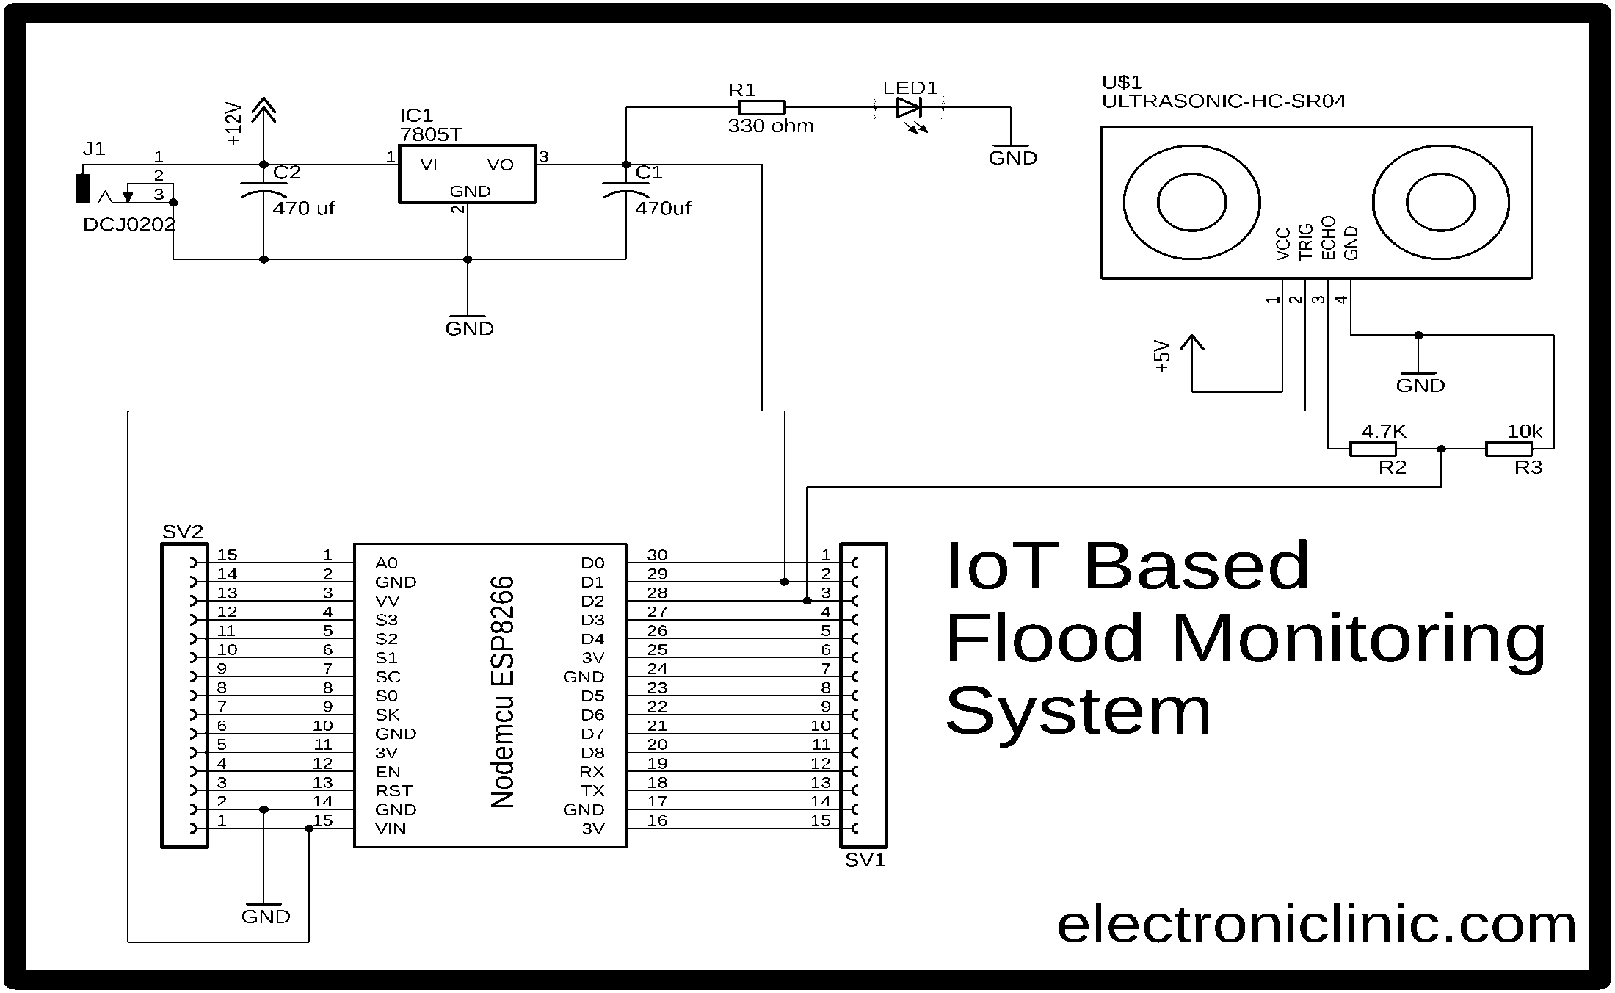
ARDUINO INTEGRATION:

Slide 8
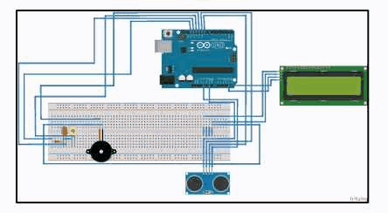
IMPLEMENTATION AND SIMULATION(Watch simulation video below):

Slide 9
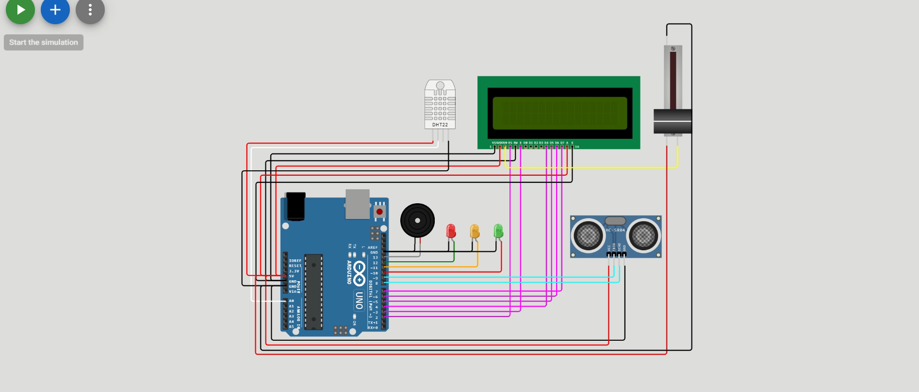
Click the above image for video

Slide 10


